Slide 1

PYTHON VISUALIZATIONS PROJECT
By Maxim Stepanyants,
Arsenii Anisimov & Irina Khochetkhova

Slide 2
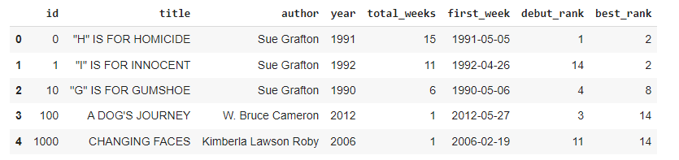
NYT BESTSELLERS DATASET

Slide 3

OUR CLAIM
It seems more likely that an author should reach rank #1 if they have multiple bestselling works

Slide 4
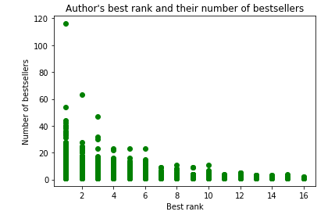
Plot #1

Slide 5
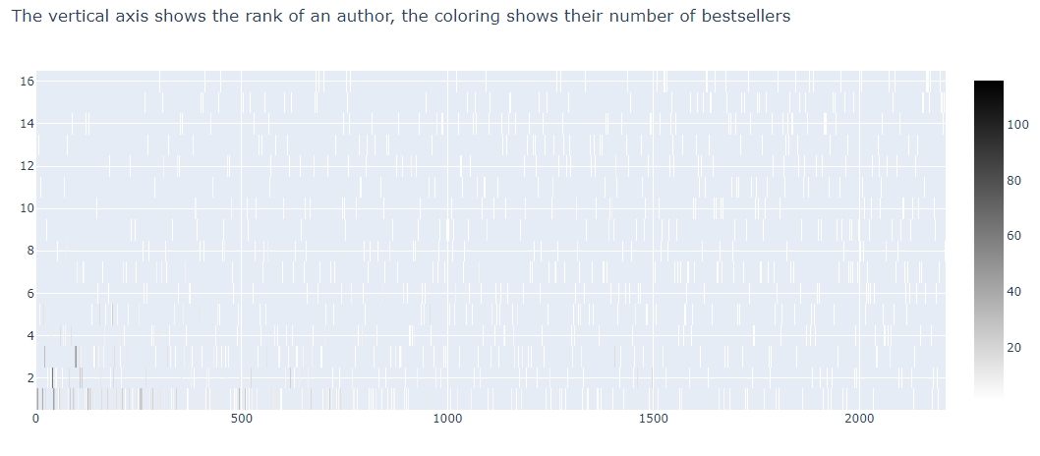
Plot #2

Slide 6
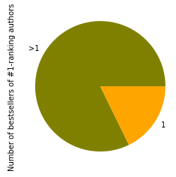
Plot #3

Slide 7
CONCLUSION
We have attempted to prove that an author reaches rank #1 quite often, provided that they have multiple works on the bestsellers list
The Pearson correlation between the best rank and the number of bestsellers of an author is, indeed, -0.36

